Slide 1
Petra Pazerini & Artur Bobovnicky
Manažér medzinárodných aktivít / Projektový manažér
Slovak Business Agency
Regional stakeholders workshop V.
21.10.2021 | SIEA

Slide 2
INNO INDUSTRY Zlepšenie inovačných politík August 2019 – Január 2023
Projekt realizuje SBA spolu s ďalšími 9 partnermi zo Slovinska (vedúci partner), Španielska, Švédska, Rakúska, Anglicka, Maďarska, Lotyšska, Portugalska a Rumunska
Hlavným cieľom projektu je zvýšiť počet klastrov, ktoré realizujú aktivity podporujúce prechod na priemysel 4.0 do roku 2022 a to prostredníctvom zlepšenia a transformácie regionálnych a národných politík v partnerských krajinách.

Slide 3
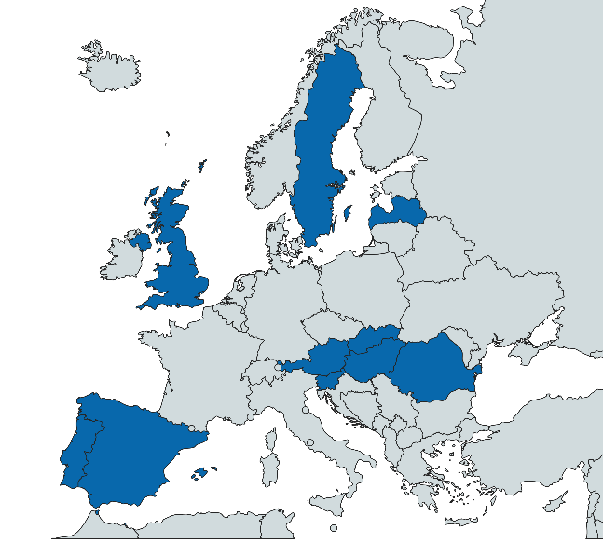
Konzorcium
10 projektových partnerov:
RRA Posavje (SI, lead)
ecoplus (AT)
MoE Latvia (LV)
AMUEBLA (ES)
CIEBI (PT)
RISE (SE)
SBA (SK)
Westpannon (HU)
CLUSTERO (RO)
Buckinghamshire BF (UK)

Slide 4
Analýza súčasného stavu v partnerských regiónoch - SWOT - Best practices - Regionálny Stakeholders Workshop INNO INDUSTRY benchmarking - 2 Regional Stakeholders Workshopy - 4 Interregionálne Stakeholders Workshopy (study visits) Vytvorenie Akčných plánov - 2 Regionalne Stakeholders Workshops - 2 Interregional Stakeholders Workshops (Portugalsko, Slovensko)
Implementačný plán
Fáza 1 – 2 ROKY
Klastrové aktivity na podporu Priemyslu Industry4.0
Fáza 2 – 1 ROK
Implementácia akčných plánov a monitoring
Notes:
IRSWS – Share and learn of best practices and cluster possibilities to foster industry4.0:

Slide 5
Výstupy projektu
SWOT analýza
Best practices
Akčný plán
Aktivita 1
Inovačné poukážky národného projektu Inovujme.sk na vylepšenie schémy MH SR
Aktivita 2
Monitoring a hodnotenie efektivity finančných grantov pre nové klastre na vylepšenie schémy MH SR
V prípade Slovenska je nástrojom na zlepšenie Operačný program Integrovaná infraštruktúra (pôvodne OP výskum a inovácie), ktorý ponúka nástroje tak na podporu klastrov ako aj prechodu na Priemysel 4.0.

Slide 6
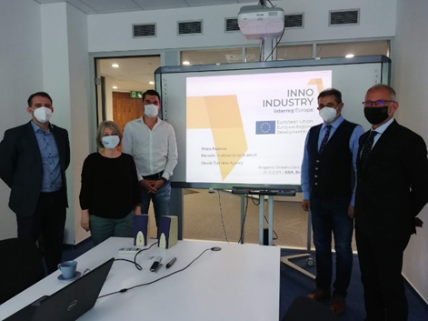
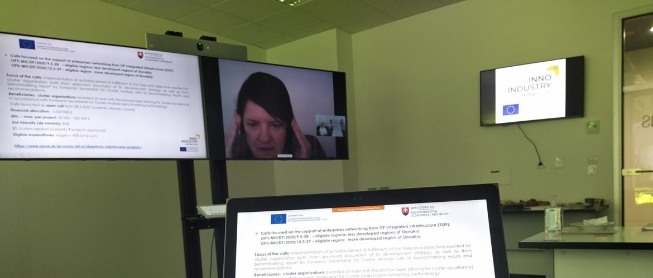
Projektové aktuality
Synergia spoločných aktivít stakeholderov na vypracovanie realistického akčného plánu pre Slovensko.
31. máj 2021
Inšpirácia príkladom monitorovania klastrového programu Dolné Rakúsko.
25. jún 2021
Viac o projekte INNO INDUSTRY (Interreg Europe) http://www.sbagency.sk/sba-0

Slide 7
SK Akčný plán
2 actions that were developed on the basis of:
the previously developed SWOT analysis (Dec. 2019, InnoIndustry)
Best practices from the project partners and Interred Policy Learning Platform (Austria, Slovenia, Hungary, Finland, Portugal)
Close cooperation with key stakeholders, e.g. clusters, Ministry of Economy – Managing Authority, Ministry of Economy – Section of Competitiveness, SIEA

Slide 8
Action 1
Title: improvement of the policy measure DM 15/2017 (innovation vouchers provided by Ministry of Economy)
Main features:
Paperless administration
Open calls
Acceleration of approval process
Aid ammount from 2.000 up to 50.000 €
Aid intensity 85%
Extended scope of activities

Slide 9
Action 1 – Time plan of activities
2019, Sept-Nov. Idea generation and first discussions, available best practice collection and analysis
2019, December INNO Industry Regional Stakeholders Workshop (Dec.11): Setting the ideas and team composition
2020, January First meeting with World Bank on CURI
2020, March INNO Industry Regional Stakeholders Workshop (March 9): Discussion on the actual development of the policy measure, barriers etc.
2020, March INNO Industry Interregional Study Visit – online (March, 3-5) - Krems
2020, April Analysis of best practices provided by INNO Industry Validation of the activities with industry stakeholders
2020, June Drafting the State Aid Scheme de Minimis
2020, December INNO Industry Regional Stakeholders Workshop (Dec. 9): Update on current development, preparation of the topics to be supported via the policy instrument
2021, April Approval of the State Aid Scheme by relevant Authority (Antipomonoply Office of the SR) No.DM 10/2017, amendment No.4
2021, May INNO Industry Regional Stakeholders Meeting (May 31)
2021, May Financial allocation for the program approved by MoE SR

Slide 10
Action 1 – Current Status
July 2021 First call launched – Banska Bystrica region,within CURI initiative by World Bank, MoE and with support of EC
October 2021 Second call – Slovakia (except BB), new type of activities (e.g. IPR)
November 2021 Third call Banska Bystrica
January 2022 Fourth call planned, Slovakia

Slide 11
Action 2
Title: improvement of the policy measure Scheme DM 13/2017 and Scheme for support for clustering of enterprises no. DM - 3/2020)
Goal: to introduce monitoring and evaluation of the effectiveness and efficiency of the financial non-refundable grants for clusters (in the early stage of development)
Main features:
a set of performance criteria has to be developed and used
during 2021 only early stage cluster assessment and monitoring tool is going to be developed
similar approach will be implemented in development of the tool for mature clusters and excellent clusters (second and third level).

Slide 12
Action 2 – Time plan of activities
2019, Sept. First ideas how to better monitor and assess the performance and impact of cluster programs were initiated
2019, Dec. INNO Industry Regional Stakeholders Workshop (Dec.11): Setting the ideas and team composition for Action 2
2020 Description and first drafts of the assessment and monitoring model (Action 2) prepared
2021, May Discussion with clusters
2021, June INNO Industry Regional Stakeholders Workshop (June 25): discussion about the s Action 2 of the Action Plan, contributions from the MoE ; Regional Stakeholders Workshop, 25.06. 2021 with ECO PLUS – Lower Austria – description of activities in Lower Austria on Monitoring of the LA Cluster Programme
2021, August Inputs from Hungarian Ministry of Finance, responsible for performance assessment and monitoring of Hungarian clusters received and analyzed

Slide 13
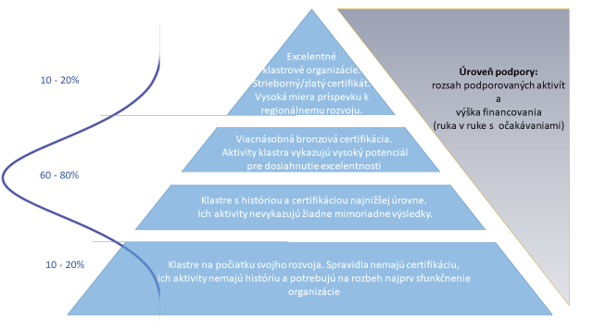
Action 2 – Current Status

Slide 14
Next Steps
Study visit in Portugal, verification of the best practice on site (voucher scheme) – November 2021
High level conference in Slovakia – on line, January 2022
Launch of the monitoring and evaluation scheme, stage 1 – 1.Q 2022
Launch of the monitoring and evaluation scheme, stage 2 – 3.Q 2022

Slide 15
Ďakujeme.
Petra Pazerini
Slovak Business Agency
pazerini@sbagency.sk
02 20 36 33 73

